Slide 1
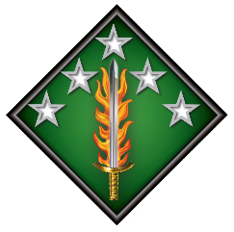
20th CBRNE Command Overview
CH (LTC) Daniel D. Kang
Command Chaplain
Notes:
Distinctive Unit Insignia (DUI):
The flaming sword highlights this country’s aggressive stance with the battle against domestic and international terrorism. Green alludes to the Army as a land force. Black is in honor of the personnel who died on September 11, 2001, and the War Against Terror. The motto translates to “Liberty We Defend.” The stars represent the five mission elements of the Command: Chemical, Biological, Radiological, Nuclear, Explosives. The green fleur-de-lis is symbolic of the first modern day use of chemical warfare in Europe during World War I.
Shoulder Sleeve Insignia (SSI):
The stars represent the five mission elements of the Command: Chemical, Biological, Radiological, Nuclear, and Explosives. The stars also underscore the Command as a multi-component unit in today’s threat environment. The flaming sword highlights this country’s aggressive stance with the battle against domestic and international terrorism. Green alludes to the Army as a land force. Black is in honor of the personnel who died on
September 11, 2001, and in the War Against Terror.

Slide 2



Task Organization
++
CBRNE
CBRNE Analytical Remediation Activity
122-person TDA/civilian organization to recover, transport, conduct emergency response, escort, and remediate chemical warfare material globally with four expeditionary forensic laboratories and four remediation response teams
GS-15
III
III
X
CARA
52
71
48
Ø
II
II
II
NDT
Nuclear Disablement Team (NDT)
11-person team of nuclear infrastructure experts in exploiting facilities with nuclear-related material
184
II
3
II
2
II
Ø
WMD Coordination Team (WCT)
17-person team of CBRN, EOD, and nuclear counter proliferation experts equipped with intelligence and communications support focused on CBRNE planning at the Army Service Component Command and
Theater Special Operations Command level
192
79
22
WCT
II
II
242
I
83
TE
II
21
WMD
110
TRA
Area Medical Laboratory (AML)
Expeditionary laboratory consisting of three modular teams to provide CBRN threat assessment, theater level validation, and health hazard consult
1
AML
EOD
2 Groups
5 Battalions
32 Companies
288 Teams
CBRN
1 Brigade
4 Battalions
5 Companies (TE)
10 Companies (HR)
OPCON
Consequence Management Unit (CMU)
Army Reserve CBRN technical experts in CBRN threats and countermeasures
CMU
EOD Operations
Identify, render safe, exploit and eliminate CBRN & explosive hazards (conventional
and improvised)
CBRN Operations
Detect, identify, exploit, and decontaminate CBRNE threats and mitigate hazards
Total Force Partnership Program
20th CBRNE Command has a partnership with designated US Army Reserve (USAR) and Army National Guard (ARNG) units
Legend:
CBRNE: Chemical, Biological, Radiological, Nuclear, Explosives
EOD: Explosive Ordnance Disposal
HR: Hazard Response
OPCON: Operational Control
TE: Tech Escort
TRA: Training Readiness Authority
WMD: Weapons of Mass Destruction
++
X
X
III
X
76
ORC
415
455
111
31
USAR - UT
USAR - SC
USAR - NV
ARNG - AL
ARNG - AL
Notes:
COMMAND ORGANIZATION
The command has nearly 85% of the US Army’s active-duty EOD (Explosive Ordnance Disposal) and CBRN (Chemical, Biological, Radiological and Nuclear) units. The organization is currently commanded by a one star general and is comprised approximately 3,800 Soldiers and 230 Civilians. (Except Hawaii, Alaska, and Korea)
The command has a deployable HQ, two EOD Groups, One CBRN Brigade, the CBRN Analytical Activity, a WMD EOD unit, Nuclear Disablement Teams, and WMD Coordination Teams.
Prepared to deploy a Joint Task Force capable HQs for counter WMD missions
The Command has elements (WCTs & NDTs, plus EOD teams) routinely deployed to 5 COCOMs including CENTCOM, AFRICOM, INDOPACOM, NORTHCOM and SOUTHCOM.
Our deployed operations are Support to Special Ops (EOD), Counter Explosive Threats (CENTCOM), CBRN Operations (INDOPACOM)
Plus, Homeland Response – Very Important person Protection Support Activity (VIPPSA), EOD Emergency Response (On and off-post response to found military munitions, Defense CBRN Response Force – Mass Casualty decontamination for domestic consequence management

Slide 3
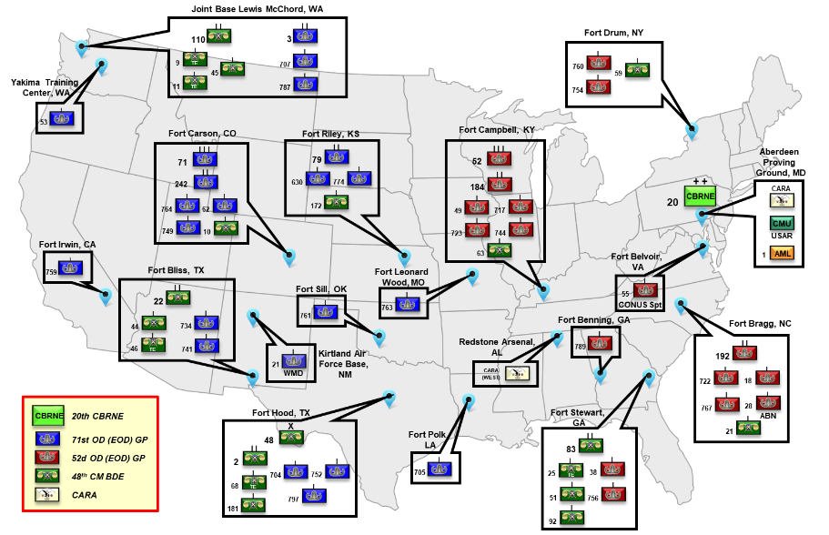
Command Footprint
Approx. 3,800 Soldiers and Civilians across
16 States, 19 Installations
Operating Routinely Across the Globe
12 – FORSCOM
3 – TRADOC
2 – AMC
1 – MDW
1 – Air Force
Notes:
COMMAND FOOTPRINT
The Command is comprised of approximately 3,800 Soldiers and 230 Civilians.
The Command is dispersed over 19 Installations in 16 States and 8 of 10 FEMA Regions. The installations have varying Senior Mission Commanders - 12 are FORSCOM; 3 are Training and Doctrine Command (FBGA, FBTX, FSOK); 2 are Army Material Command (APG, RSA); 1 is Military District of Washington (FBVA); and 1 is Air Force (Kirtland AFB).
This dispersion distributes our EOD and CBRN forces in close proximity to major Army combat units, other Services, as well as CONUS first responders.
The 71st EOD Group has responsibility for EOD emergency response West of the Mississippi and the 52nd EOD Group has the East.
With the restationing of 71st EOD Group to JBLM in 2023 and the restationing of 79th EOD BN to FRKS in 2020, the command will have Groups/Brigades aligned with Corps and BNs aligned with Divisions on nearly every FORSCOM installations (except Fort Drum).

Slide 4
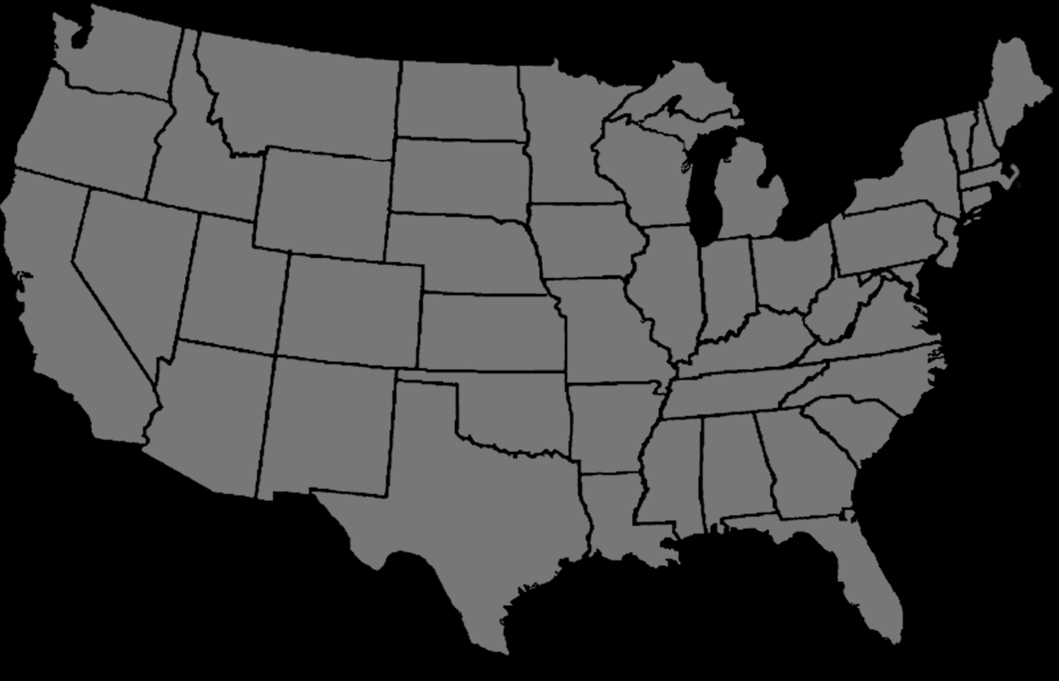

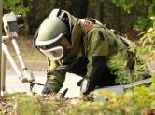
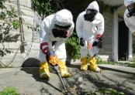
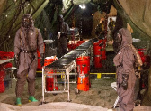
Homeland Response
Very Important Person Protection Support Activity (VIPPSA)
Mission: EOD Teams perform ~50-100 missions per month to secure the President, Vice-President, their families, foreign Heads of State, and National Special Security Events
Core Elements:
The equivalent of four EOD companies support US Secret Service and Dept of State
EOD Emergency Response
Mission: On & off-post response to found military munitions, IEDs, and other explosive hazards (~130 responses / month)
Core Elements:
18 EOD teams
CARA
Remediation/
Chemical Surety Escort
Mission: Remediation on former defense sites and escort of chemical surety material with organic aviation assets
Core Elements:
CARA Remediation Response Teams
CBRN Elements
CARA Aviation Team
National Technical Nuclear Forensics (NTNF)
Mission: Collection of ground samples following CONUS post-blast response for FBI-led Task Force
Core Elements:
Nuclear Disablement Team
CBRNE Response Team
Defense CBRN Response Force (DCRF)
Mission: Mass casualty decontamination for domestic consequence management
Core Elements:
1 CBRN Battalion
3 CBRN Companies
WMD Coordination Team
Notes:
HOMELAND RESPONSE
Our Homeland Defense mission consists of daily requirements and Prepare to Deploy requirements:
The Command has a Battalion HQ, three CBRN companies, and a WMD Coordination Team (WCT) prepared to deploy in support of Joint Task Force Civil Support and US Northern Command for the DCRF (Defense CBRN Response Force) mission. These forces provide mass decontamination and consequence management following a domestic incident.
The Command has a Nuclear Disablement Team (NDT) and a CBRNE Response Team (or CBRN Hazard Assessment Platoon) dedicated to the FBI-led National Technical Nuclear Forensics mission. Our forces conduct post-blast collection of ground samples in the Continental U.S.
For on and off-post EOD emergency response, our command provides 18 EOD Teams (1 per installation) and also our CBRNE Analytical and Remediation Activity personnel supporting local law enforcement, conducting approximately 130 incident responses per month. These missions involve response to found military munitions, IEDs, explosive hazards, or recovered chemical munitions and materiel found throughout the Nation.
Our command has the equivalent of 4 EOD companies dedicated to supporting the US Secret Service for the Very Important Person Protection Support Activity (VIPPSA) mission conducting approximately 50-100 missions per month. These teams clear venues and National Special Security Events (NSSE) of possible explosive hazards in preparation for visits by the President, Vice-President, their families, and foreign Heads of State.

Slide 5
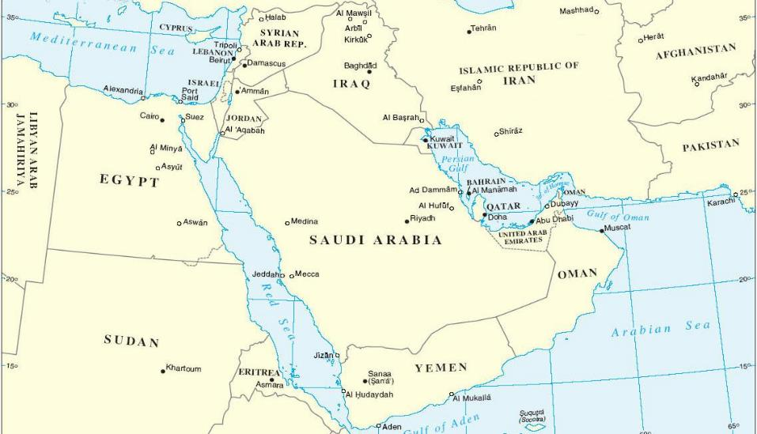
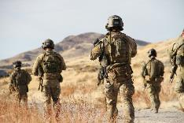
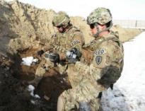
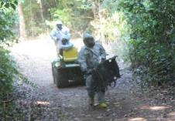
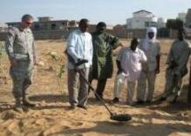
Deployed Operations
Support to Special
Operations
Mission: Provide EOD and CBRN support to Special Operations Forces
Counter IED Operations
Mission: Conduct Counter Improvised Explosive Device (CIED) & IED Defeat in the CENTCOM Area of Operations in support of Operations Inherent Resolve and Freedom’s Sentinel
CBRN
Operations
Mission: Provide CBRN assessment, reconnaissance, characterization, and decontamination in the INDOPACOM AOR
Recovered Chemical Warfare Material
Mission: Conduct recovery of U.S. chemical munitions, technical escort of surety material (air and ground), and remediation of former chemical weapons burial sites.
Theater Security Cooperation
Mission: Provide basic instruction on demolition operations, ordnance identification, explosive hazards/safety/storage, minefield clearance & handheld detector operations and CIED
Core Elements:
3-5 EOD COs in support of SOF units
Tiered CBRN / EOD Units
Core Elements:
EOD BN Headquarters
3-5 EOD Companies
Mobile Expeditionary Lab
Core Elements:
CBRN Company (Hazard Response)
Core Elements:
CBRNE Analytical & Remediation Activity (CARA) Remediation Response Teams
Core Elements:
1 EOD Company
Notes:
DEPLOYED OPERATIONS
Our command has forces that provide EOD and CBRN support to Special Operations Forces. These units are habitually aligned in support of specific SOF customers and they routinely train and exercise with them.
The command has forces currently deployed in Afghanistan (to conduct counter IED and IED Defeat) and Iraq (to conduct Green Zone Security), and Kuwait (TF Hellhound). IED’s remain the highest threat that cause the preponderance of casualties in theater.
The command has a CBRN Company (Hazard Response) on a rotation to Korea ISO of the rotating Brigade Combat Team to provide assessment, reconnaissance, and characterization.
Our CARA organization deploys routinely to conduct recovery of found US Military chemical munitions both in CONUS (recent operations in Delaware and California) and OCONUS (Panama, Philippines, Australia, Guam).
The Command has forces deployed to Africa and Europe for Theater Security Cooperation activities, specifically Humanitarian Mine Assistance training. Our forces provide basic instruction on demolition operations, ordnance identification, explosive hazards/safety/storage, minefield clearance and handheld detector operations.

Slide 6
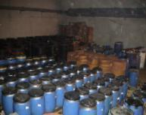
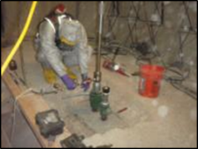
Theater CBRNE Command Capabilities
The 20th CBRNE Command HQs is designed as a scalable and tailorable mission command HQs
for CBRN and EOD operations in support of the Theater Commander.
TASK FORCE MCCALL, Tuwaitha Nuclear Research Center
Operation DRAGON’S EGG, Fallujah
Deployable Command Post:
A deployable command post with the mission to form the core of the JTF HQ, responsible to command and control forces in the execution of CBRN and EOD operations.
Capabilities:
Synchronizes a Theater Commander’s efforts to locate, seize, and secure WMD, WMD sites, means of delivery, related material, and expertise
Tracks, manages, and executes the range of CBRN / EOD missions for the supported commander including theater opening, fixed/terrain decontamination, unexploded ordnance, and support to counter IED operations
Assists the supported commander with employment of CBRN and EOD assets at the operational/tactical level of war
Capable of providing mission command of Combined/Joint CBRNE forces and integrating inter-organizational partners into the spectrum of EOD and CBRN operations, with a historical emphasis on Elimination.
Maintains contact with technical reach back for CBRN and EOD threats
Main Command Post:
A home station command post
with the mission to provide mission command of CONUS technical operations, recovery / disposal of munitions, site exploitation / elimination operations, and contingency planning.
Notes:
Tailorable CBRNE Capabilities
Our Command HQ is comprised of an Operational Command Post and a Main Command Post. We can also rapidly deploy a Tactical Command Post – a tailorable and scalable mission command element to provide staff augmentation to conduct initial CBRNE planning to the supported commander.
For future CBRNE/WMD contingencies we aggressively train and are prepared to establish a JTF for WMD Elimination in support of any Combatant Commander

Slide 7
CS & UMTs
71ST OD GP (EOD)
FCCO
52ND OD GP (EOD)
FCKY
48TH CHEM BDE
FHTX
20TH CBRNE CMD
APG, MD
22ND CHEM BN
FBTX
110TH CHEM BN
JBLM, WA
83RD CHEM BN
FSGA
184TH OD BN (EOD)
FCKY
192ND OD BN (EOD)
FBNC
3RD OD BN (EOD)
JBLM, WA
79TH OD BN (EOD)
FRKS
242ND OD BN (EOD)
FCCO
2ND CHEM BN
FHTX
Notes:
The command will have Groups/Brigades aligned with Corps and BNs aligned with Divisions on nearly every FORSCOM installations (except Fort Drum).
Key take away is CBRN and EOD are highly technical and special purpose formation – Especially EOD units usually deployed and attached a team level (2-3 men team) or sometime PLT levels (3 teams) to BCT; Company to DIV level.
They are highly stress and isolated group of SM – typically higher incidents of suicide ideations and attempts due to easily forgotten, left out and isolated. Their unit Chaplain will not deploy with company, PLT, teams.
EOD teams to be included and supported by BCT UMTs when they deployed CTC rotations, WFX, and CPX.
CHEM unit usually deploy company level to BCTs and BNs to DIV level.
ALL UMTs dispersed in: 8 different installations and in 9 different states.
No our own RS SOP – all UMTs must nested with the ADCON unit policy and guidance.
Important to have accountability and mentorship from the local BCT and DIV Chaplains and Sr. RAS NCOs.
My own observation: Does UMTs have (or need) MOPP gears with distinguished mark of Chaplain?

